Slide 1


K.RAMAKRISHNAN COLLEGE OF TECHNOLOGY
(AUTONOMOUS), TRICHY.
ONLINE VOTING SYSTEM
PRESENTED BY
AROCKIA JERISH RAJ M
2303811710421011
SUPERVISOR
Mr. M. Saravanan, M.E.,
AP/CSE.
Notes:
<number>

Slide 2
PRESENTATION OVERVIEW
Objective
Project Introduction
Problem Statement
Methodologies (Programming concepts relevant to problem statement)
Architecture of the proposed system
List of Modules
Merits
Results and Discussion
Queries
Notes:
<number>

Slide 3
OBJECTIVE
The objective of this project is to develop a secure and user-friendly online voting system that allows voters to cast their votes, ensures one vote per user, and provides accurate real-time results.
Notes:
<number>

Slide 4
PROJECT INTRODUCTION
This project is an online voting system designed to simplify and secure the voting process. It allows users to cast their votes digitally, ensures each voter can vote only once, and provides real-time results, making the voting process efficient, transparent, and accessible.
Notes:
<number>

Slide 5
PROBLEM STATEMENT
Here are some concise problem statements for your online voting system project:
1. Ensuring that each voter is authenticated and can vote only once to prevent duplicate voting.
2. Providing a secure and transparent system to prevent unauthorized access and manipulation of votes.
3. Simplifying the voting process to make it more user-friendly and accessible for all users.
4. Delivering accurate and real-time results while maintaining the integrity of the voting data.
Notes:
<number>

Slide 6
METHODOLOGIES
1. Object-Oriented Programming (OOP)
2. Modular Design
3. Validation and Security
4. Event-Driven Programming
Notes:
<number>

Slide 7
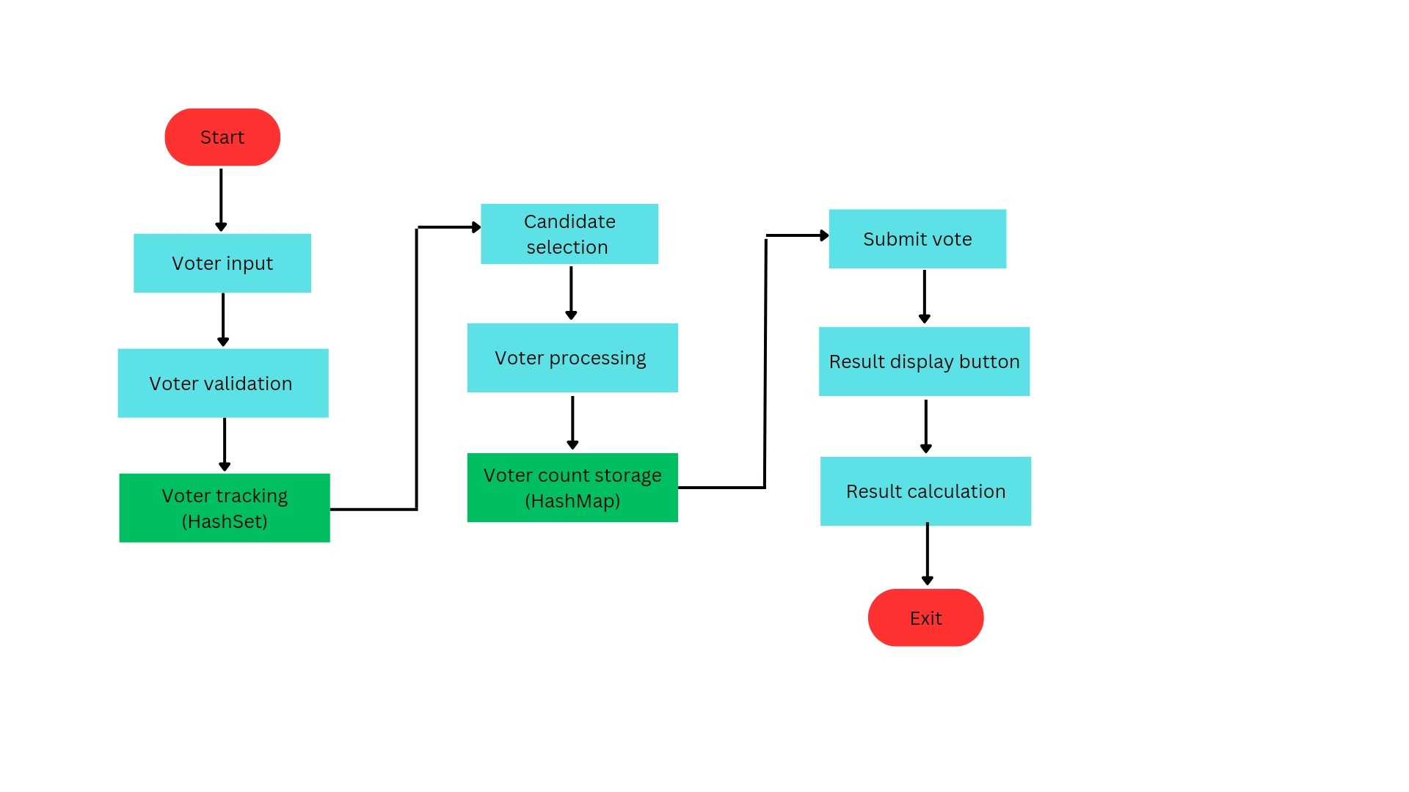
ARCHITECTURE OF THE PROPOSED SYSTEM
Notes:
<number>

Slide 8
LIST OF MODULES
1. User Interface (UI) Module
2. Logic Processing Module
3. Data Management Module
4. Results Display Module
Notes:
<number>

Slide 9
MODULE DESCRIPTON
1. User Interface (UI) Module: Provides a simple interface for voters to input their details, select candidates, and interact with the system.
2. Logic Processing Module: Validates voter inputs, processes votes, and ensures each voter can vote only once.
3. Data Management Module: Handles and stores voter information and vote counts securely.
4. Results Display Module: Displays real-time voting results clearly and accurately.
Notes:
<number>

Slide 10
MERITS
1. User-Friendly Interface: Simplifies the voting process with an easy-to-navigate design.
2. Security: Ensures each voter can cast only one vote, preventing duplicate or fraudulent voting.
3. Real-Time Results: Provides instant and accurate vote counts.
4. Transparency: Offers a clear and unbiased voting process.
5. Efficiency: Reduces manual effort and speeds up vote tallying.
6. Scalability: Can be expanded to handle larger elections.
7. Accessibility: Allows voting from remote locations, increasing participation.
Notes:
<number>

Slide 11
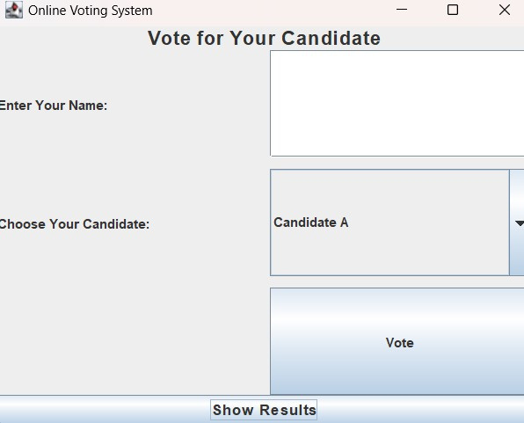
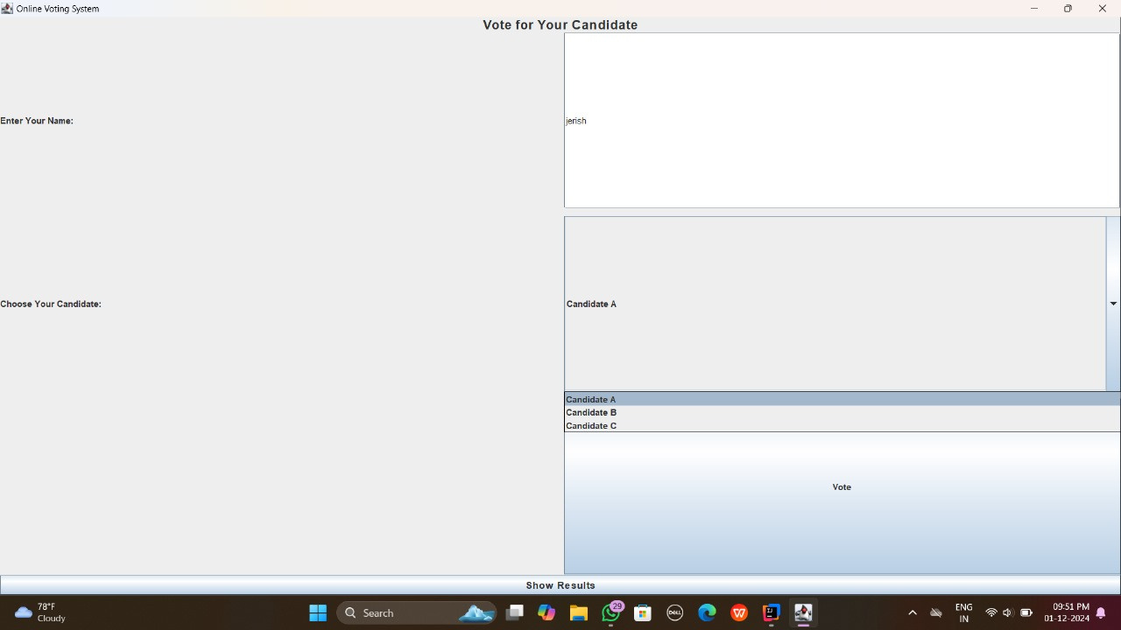
RESULTS
Notes:
<number>

Slide 12
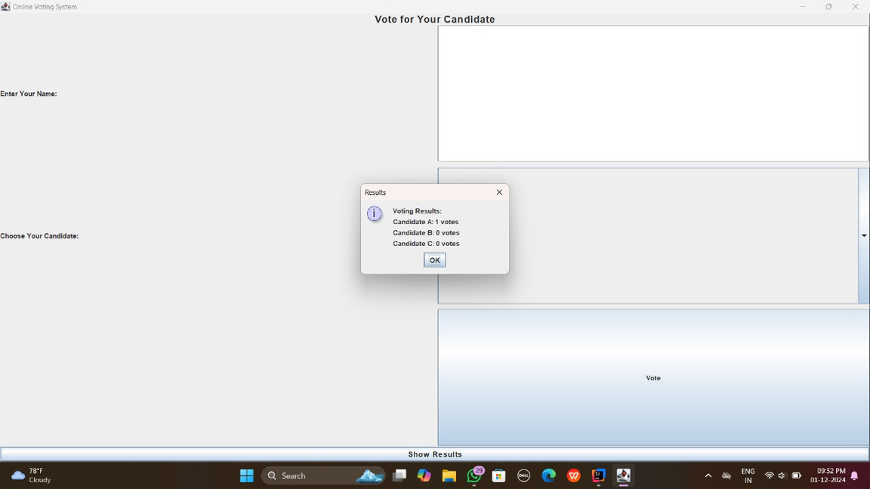

RESULTS
Notes:
<number>

Slide 13
QUERIES ?
Notes:
<number>

